Slide 1
Property Inference for Deep Neural Networks
Aleksei Zhuravlev
27.01.2023

Slide 2
Problems with neural networks
Lack of robustness. Small (imperceptible) changes to an input lead to misclassifications
Lack of explainability: it is not well understood why a network makes a certain prediction
Lack of intent when designing NNs: only learn from examples, often without a high-level requirements specification (crucial for safety-critical software systems)

Slide 3
Goal of the paper
Automatically infer formal properties of feed-forward neural networks: Pre ⇒ Post
Capture input properties, layer properties based on features
Define partitions on the input space, grouping together inputs that yield the same output by the network
Two techniques to extract network properties

Slide 4
Input and layer properties
Input property - a predicate over the input space, such that, all inputs satisfying it follow the same on/off activation pattern up to some layer and define convex regions in the input space
Layer property - encode common properties at an intermediate layer that imply the desired output behavior. Can be seen as a grouping of several input properties as dictated by an internal layer.
Decision pattern σ - specifies an activation status (on or off ) for some subset of neurons. Minimal - dropping any neuron from the pattern invalidates it

Slide 5
Interpreting Inferred Network Properties
Define regions in the input space in which the network is guaranteed to give the same label
Understand why the network makes a certain prediction on an input.
Interpret input properties using under-approximation boxes (bounds on each dimension)
Distill large networks using layer patterns with high support

Slide 6
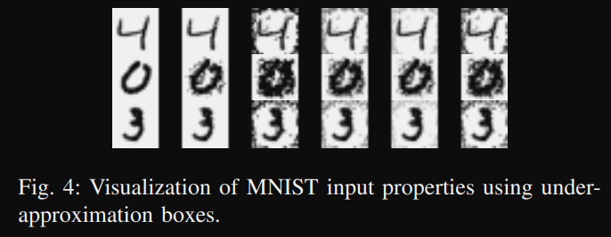
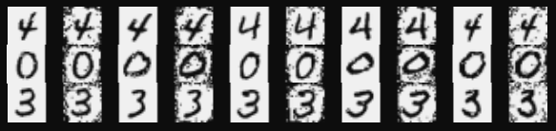

Results
Two techniques: iterative relaxation and decision tree
ACASXU: 36000 ≤ range ≤ 60760, 0.7 ≤ θ ≤ 3.14, -3.14 ≤ ψ ≤ -3.14 + 0.01, 900 ≤ v_own ≤ 1200, 600 ≤ v_int ≤ 1200: turning advisory as COC
MNIST:
MNIST, distillation: 22% saving in inference time for 0.5% decrease in accuracy

Slide 7
Further work
Compare the performance with other Explainable AI methods, e.g. feature permutation
Estimate the influence of individual neurons on predictions made by the network
Assess how random perturbation or permutation of the original dataset influence the output of the network
Train other NN models on the activation signatures for the inputs

